Slide 1
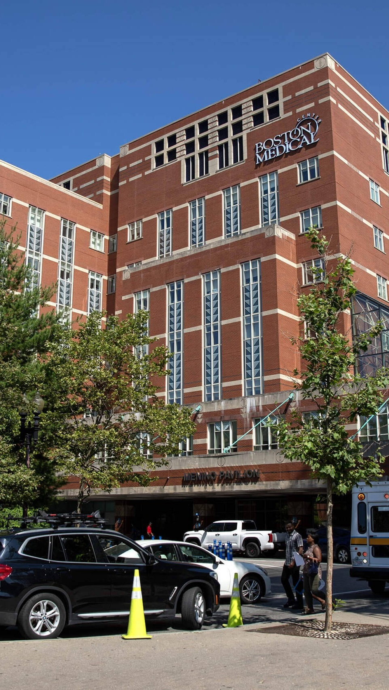
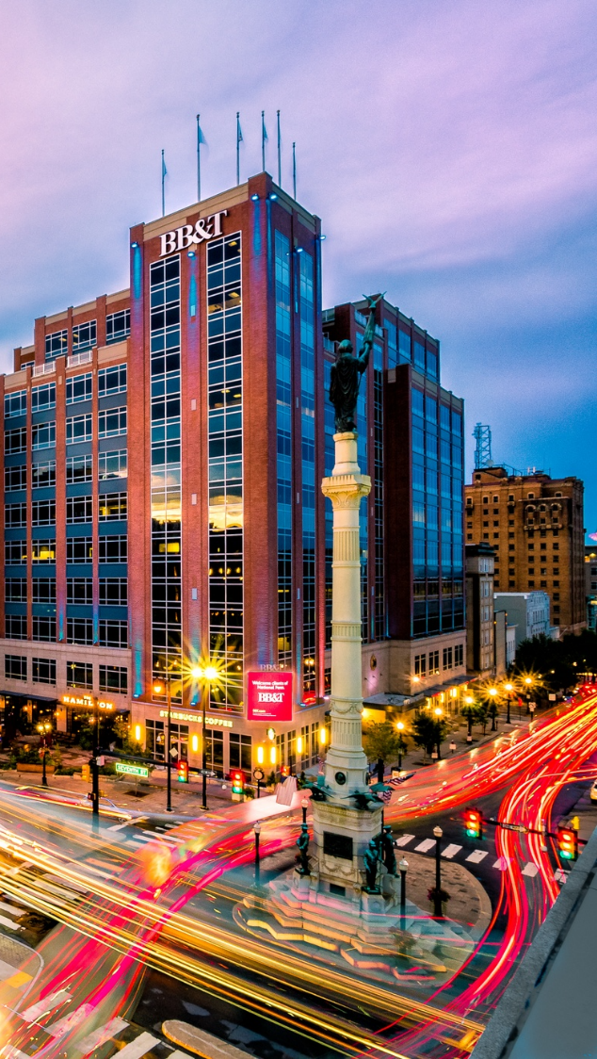

OPPORTUNITY REVIEW
DIRECT-TO-EMPLOYER GTM STRATEGY
Exploring a Boston Medical Center DTE Health Plan

Slide 2


Founded in 1979, headquartered in Indianapolis
Largest Independently-Owned Full-Service Third-Party Administrator
Specialize in Administration of Self-Funded Plans and Population Health Management​
Leader in the Direct-to-Employer Movement
We Know and Understand the Market
Experience Working with All Professional Teams: Agents, Networks, MGAs
The Key Family of Companies is a Vertically Integrated group of benefit related organizations
3,000+ Corporate Clients
3 Million Members under Management
700 Employees

Slide 3
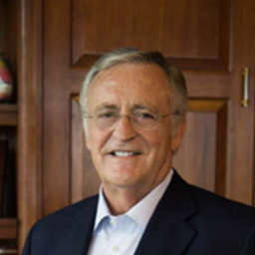

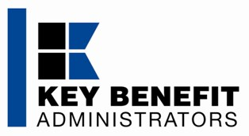
Our Founding and Heritage: 46 Years of Striving for Honesty in Healthcare

Slide 4


MARKET LEADER
IN
PRIVATE LABELED
DTE PLANS
Louisville, KY
Cincinnati, OH
Bentonville, AR
Knoxville, TN
Meridian, MS
Fort Myers, FL

Slide 5
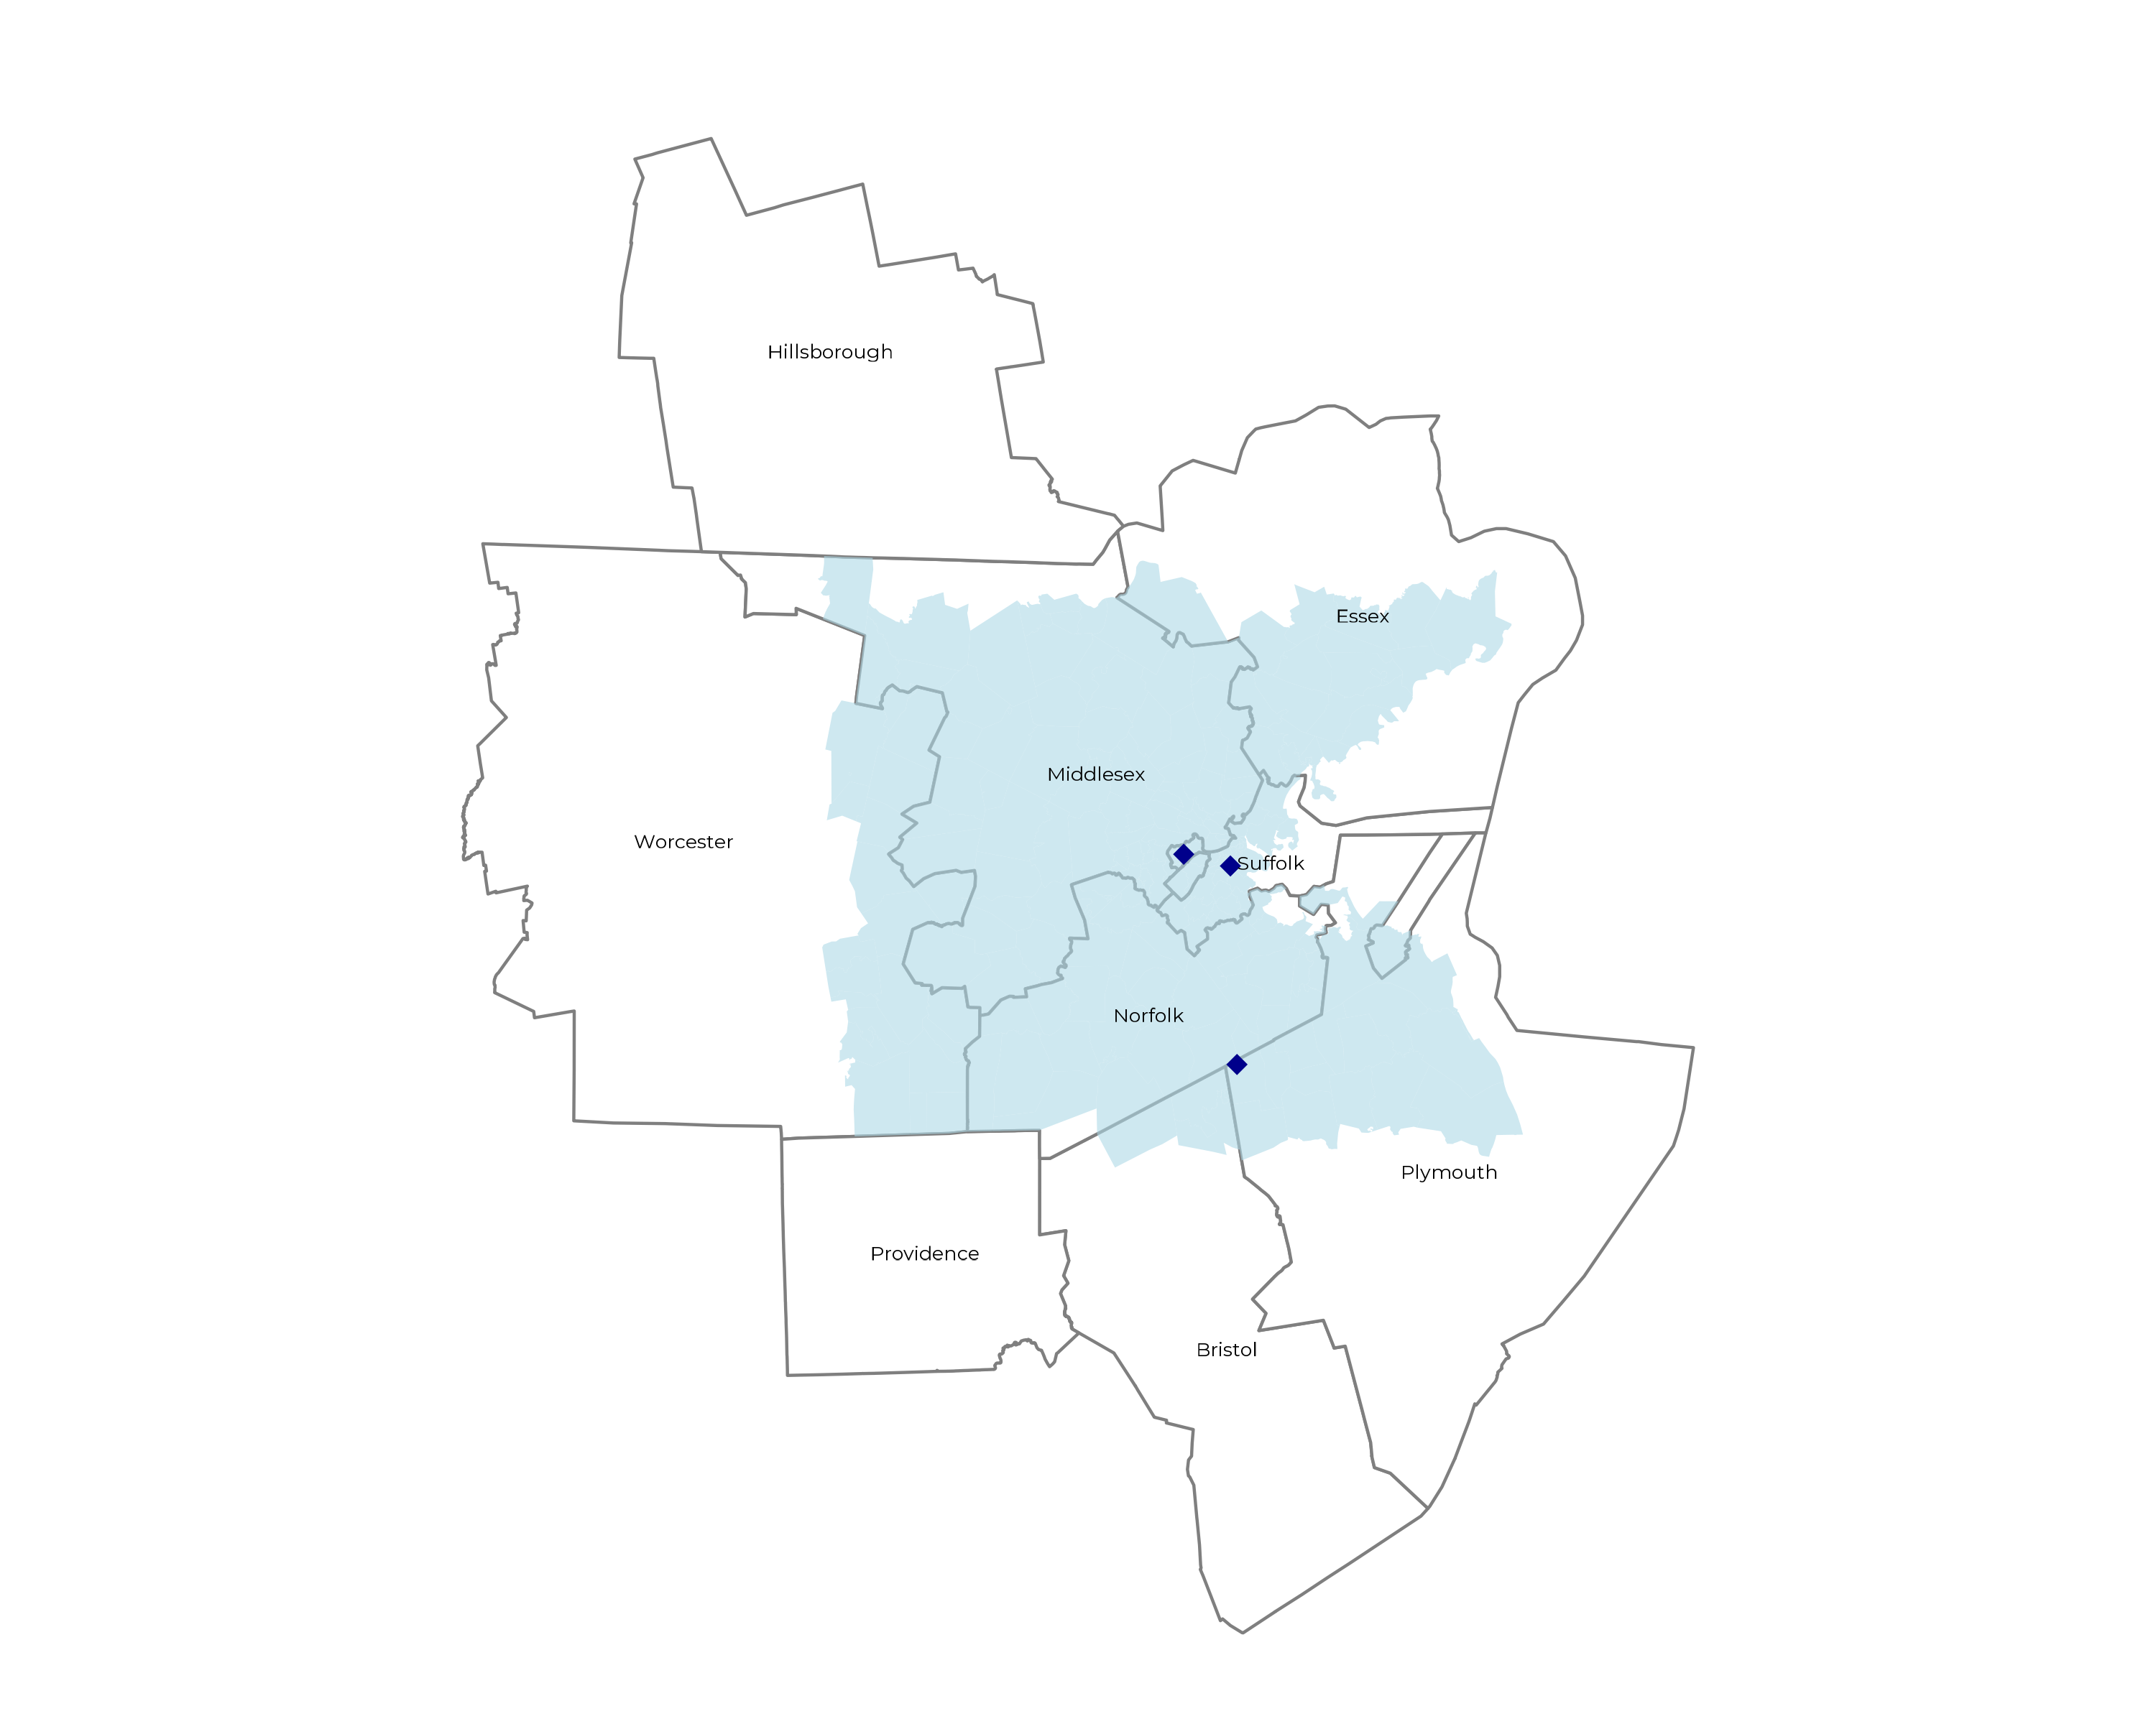
SIGNIFICANT OPPORTUNITY FOR PLAN GROWTH Researched for the below highlighted service area
Target Market 9,000+ Employers 2.2M+ Employees 4.1M+ Members
 | Employer Size Group (# of Employees)
Commercial Employers With Headquarters | 50-100 | 101-200 | 201-400 | 401-1,000 | 1,001-3,000 | 3,000+
In Catchment Area | 4,523 | 2,242 | 1,266 | 803 | 329 | 181
Total Employees at Employers | 50-100 | 101-200 | 201-400 | 401-1,000 | 1,001-3,000 | 3,000+
Headquartered in Catchment Area | 339,200 | 336,300 | 379,800 | 562,100 | 658,000 | 1,086,000
Total Members with Employers | 50-100 | 101-200 | 201-400 | 401-1,000 | 1,001-3,000 | 3,000+
Headquartered in Catchment Area | 610,600 | 605,300 | 683,600 | 1,011,800 | 1,184,400 | 1,954,800

Slide 6
Two Possible Plan Designs
Boston Medical Center lacks sufficient standalone network access in the Boston market to support an independent Direct-to-Employer plan. Strategic partnerships with other health systems are essential to ensure adequate geographic coverage and provider availability for employers and their employees.
Option 1: Partner with Mass General Brigham
Option 2: Partner with Beth Israel Lahey, UMass & Tufts
Stronger Network & More Plan Growth
Mass General Brigham commands the strongest brand recognition in Boston for both access and quality. This partnership leverages their extensive footprint to maximize plan enrollment and employer appeal.
Less Plan Growth
Without Mass General Brigham's market presence, plan adoption among employers will likely grow at a slower pace, requiring more intensive marketing and outreach efforts to achieve enrollment targets.
Less Commercial Care Steerage
Given Mass General Brigham's dominant market share, Boston Medical Center would experience minimal disruption to existing commercial patient volumes, maintaining more predictable revenue streams.
More Commercial Care Steerage
Boston Medical Center would capture significantly higher steerage of commercial patients within this smaller network configuration, potentially increasing revenue per member but serving fewer total covered lives.

Slide 7

Plan Design #1
Boston Medical Center + Mass General Brigham
This strategic partnership brings together two powerhouse health systems to create a Direct-to-Employer plan with exceptional market reach. By combining Boston Medical Center's community-focused care with Mass General Brigham's unparalleled brand recognition and extensive provider network, this option positions the plan for maximum growth and member satisfaction in the competitive Boston healthcare market.

Slide 8
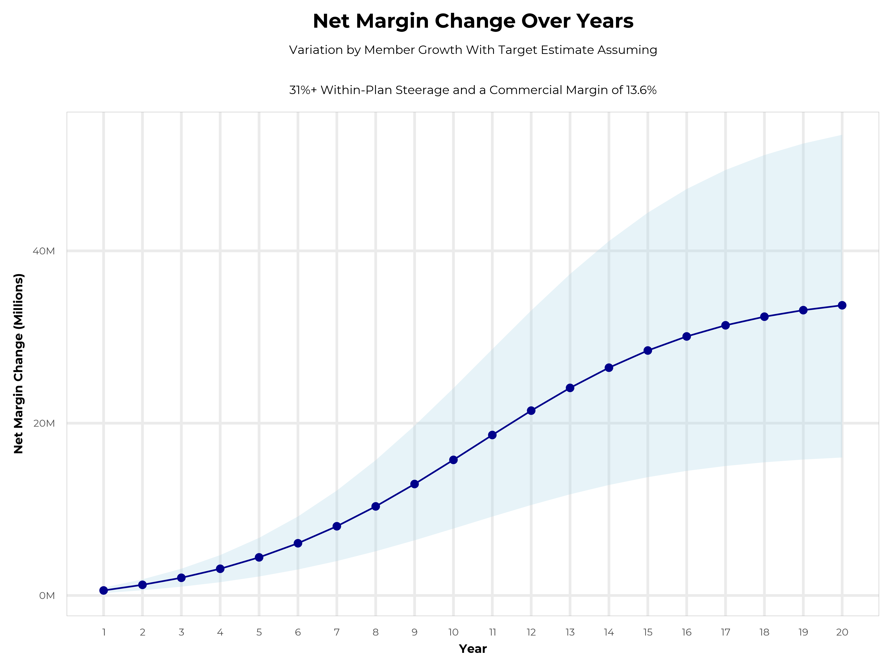
GROWING POWERFUL, LASTING PROFITABILITY
Early Stage
Gaining Name Recognition, Early Growth
New Revenue:
New Profit:
$21.51M
$2.91M
Growth Stage
Strong Reputation, Strong Growth
New Revenue:
New Profit:
$116.47M
$15.89M
Mature Stage
High Profitability, Market Saturation
New Revenue:
New Profit:
$225.44M
$30.78M
PLAN DESIGN #1: PARTNERSHIP WITH MASS GENERAL BRIGHAM

Slide 9
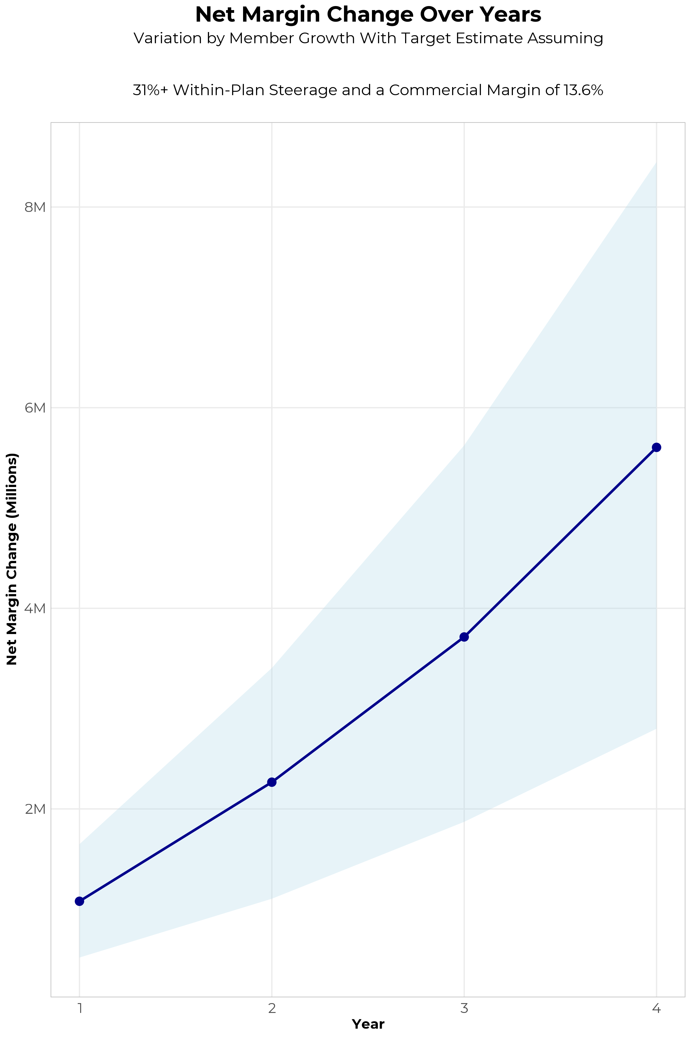
FOUR-YEAR PROJECTIONS
Target Member Growth | Target Member Growth | Target Member Growth | Target Member Growth | Target Member Growth
Metric | Year 1 | Year 2 | Year 3 | Year 4
Number of Members | 2,800 | 5,700 | 9,300 | 14,000
Incremental Margin | 1,125.2K | 2,290.7K | 3,737.4K | 5,626.2K
Network Access Fee | 4.7K | 9.6K | 15.6K | 23.5K
Implementation Fee (One-Time) | -21.0K | 0.0K | 0.0K | 0.0K
Sales and Marketing Costs | -25.2K | -25.2K | -25.2K | -25.2K
Net Margin Change | 1,079.7K | 2,266.8K | 3,714.4K | 5,604.3K
High Member Growth | High Member Growth | High Member Growth | High Member Growth | High Member Growth
Metric | Year 1 | Year 2 | Year 3 | Year 4
Number of Members | 4,200 | 8,500 | 14,000 | 21,000
Incremental Margin | 1,687.9K | 3,415.9K | 5,626.2K | 8,439.3K
Network Access Fee | 7.1K | 14.3K | 23.5K | 35.3K
Implementation Fee (One-Time) | -21.0K | 0.0K | 0.0K | 0.0K
Sales and Marketing Costs | -25.2K | -25.2K | -25.2K | -25.2K
Net Margin Change | 1,648.7K | 3,405.0K | 5,624.5K | 8,449.4K
Low Member Growth | Low Member Growth | Low Member Growth | Low Member Growth | Low Member Growth
Metric | Year 1 | Year 2 | Year 3 | Year 4
Number of Members | 1,400 | 2,800 | 4,700 | 7,000
Incremental Margin | 562.6K | 1,125.2K | 1,888.8K | 2,813.1K
Network Access Fee | 2.4K | 4.7K | 7.9K | 11.8K
Implementation Fee (One-Time) | -21.0K | 0.0K | 0.0K | 0.0K
Sales and Marketing Costs | -25.2K | -25.2K | -25.2K | -25.2K
Net Margin Change | 518.8K | 1,104.7K | 1,871.5K | 2,799.7K

Slide 10

Plan Design #2
Boston Medical Center + Major Partners
Excluding Mass General Brigham
This alternative approach creates a collaborative network combining Boston Medical Center with Beth Israel Lahey Health, UMass Memorial Health, and Tufts Medical Center. While this partnership offers a more distributed care model across multiple respected health systems, it presents distinct tradeoffs in terms of market positioning, growth trajectory, and care steerage dynamics that require careful strategic consideration.

Slide 11
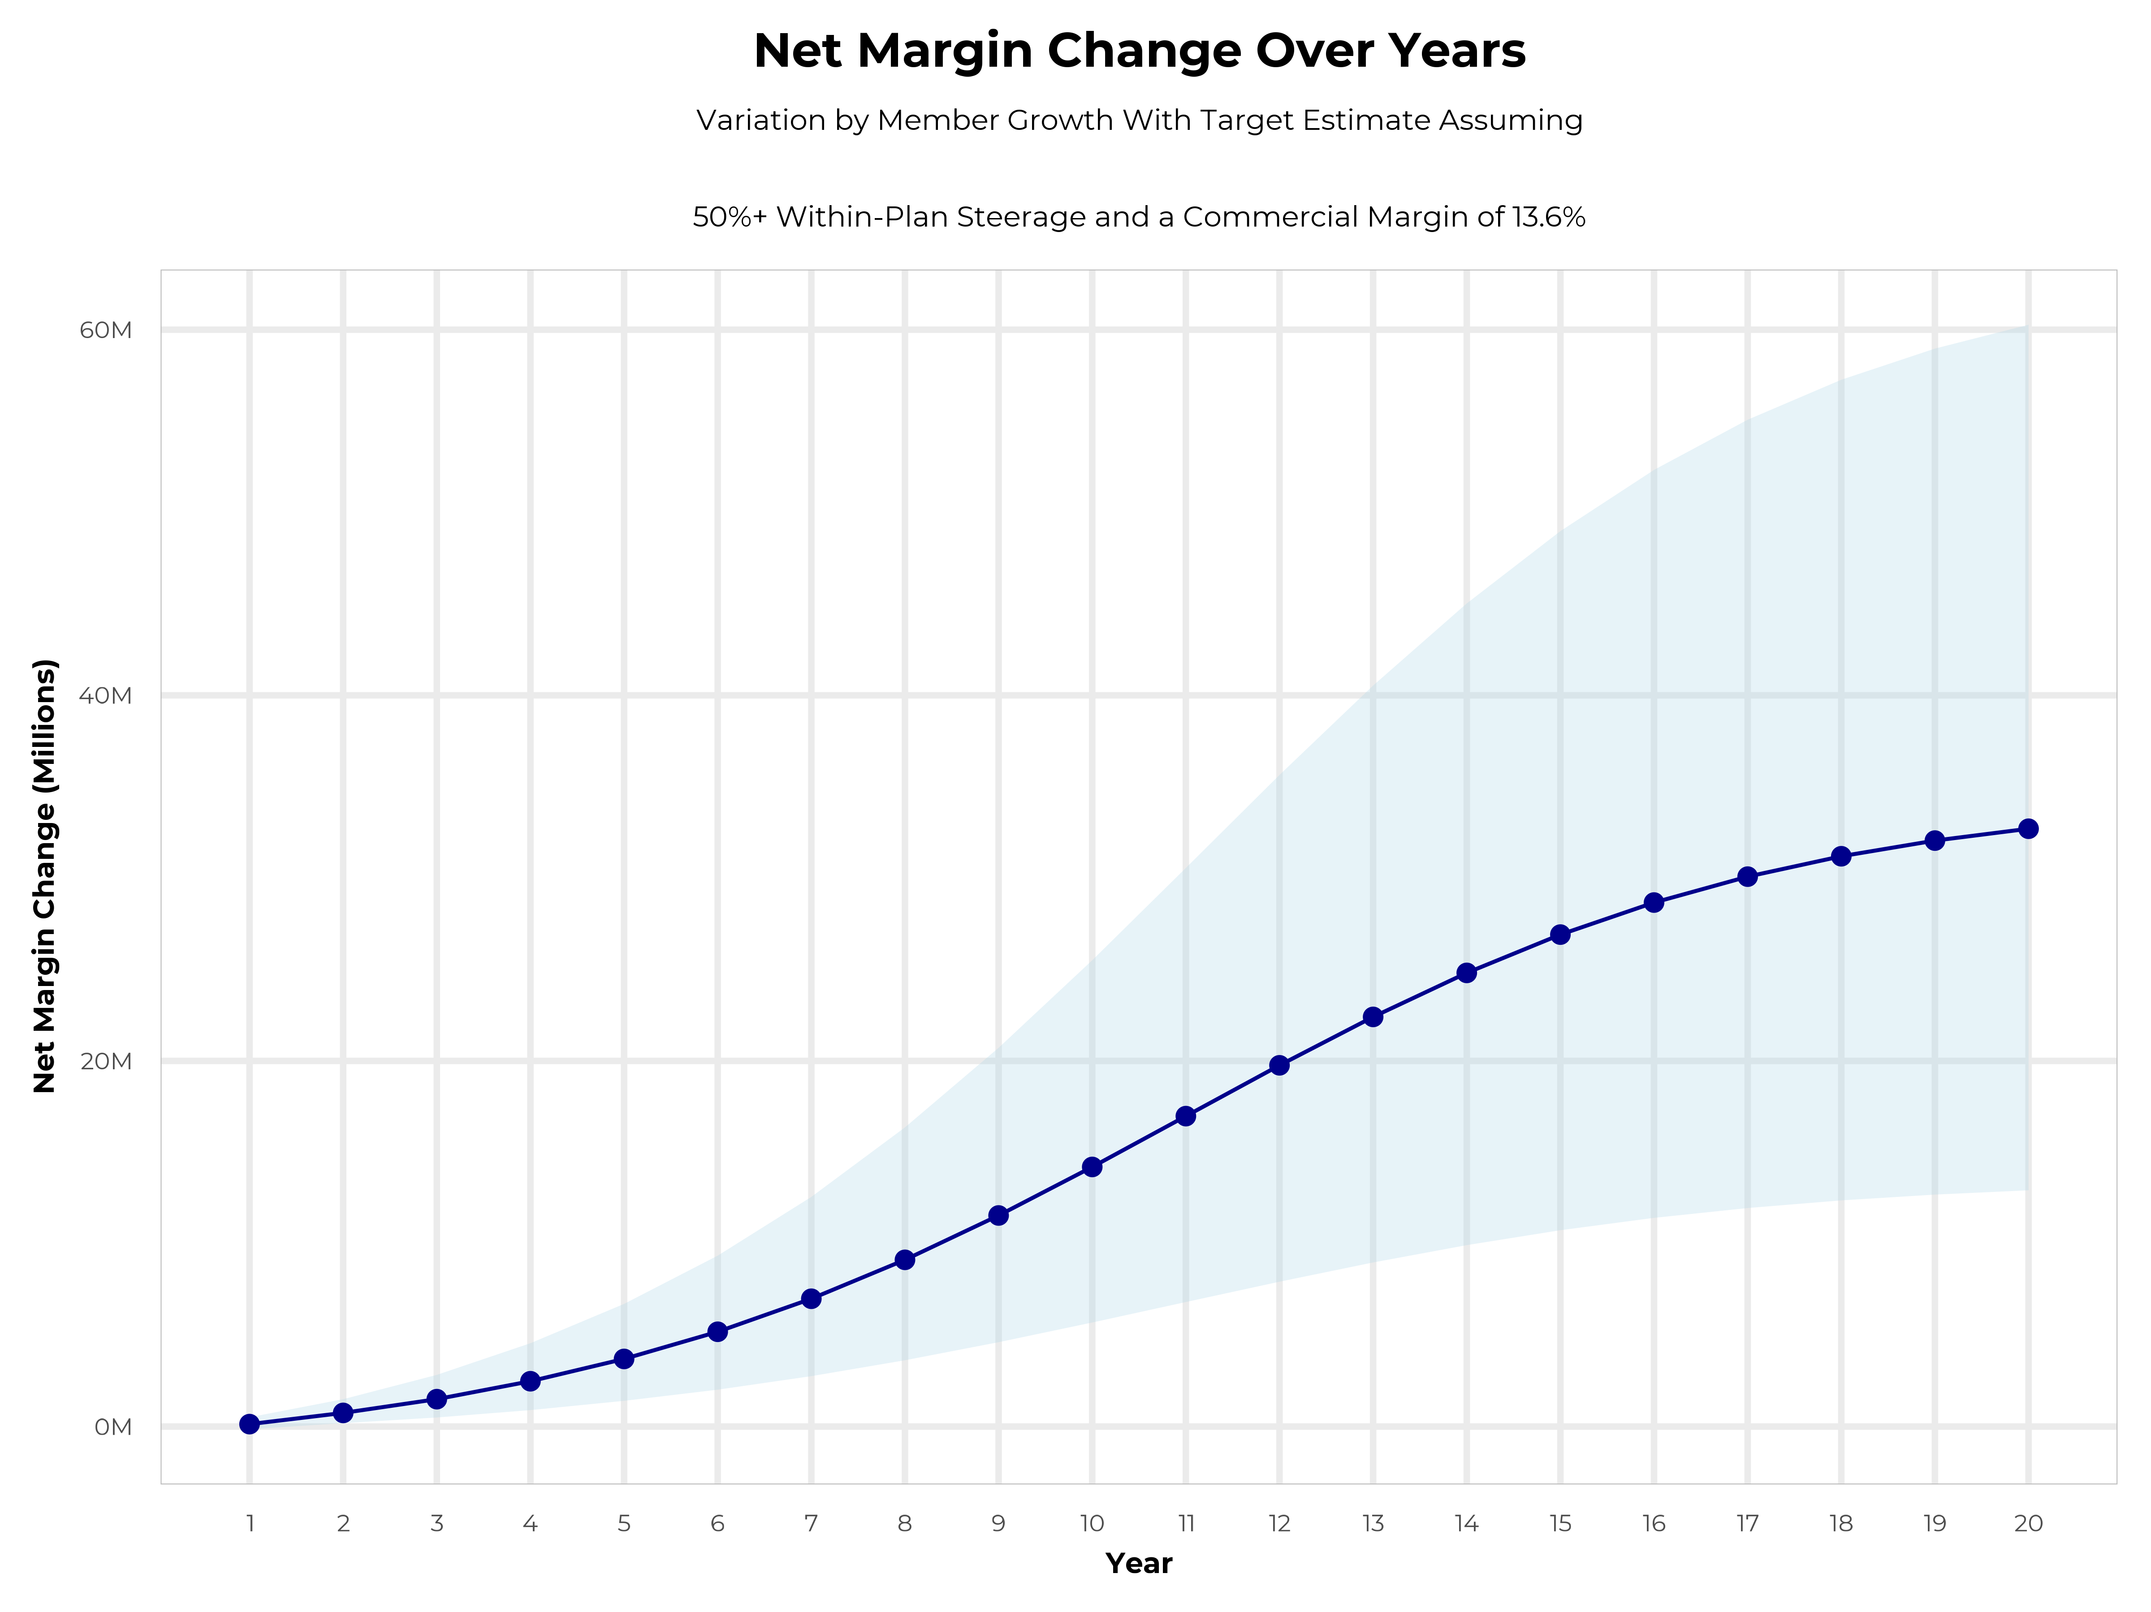
GROWING POWERFUL, LASTING PROFITABILITY
Early Stage
Gaining Name Recognition, Early Growth
New Revenue:
New Profit:
$17.88M
$2.29M
Growth Stage
Strong Reputation, Strong Growth
New Revenue:
New Profit:
$104.91M
$14.43M
Mature Stage
High Profitability, Market Saturation
New Revenue:
New Profit:
$213.28M
$29.49M
PLAN DESIGN #2: PARTNERSHIP WITH BETH ISRAEL, TUFTS AND UMASS

Slide 12
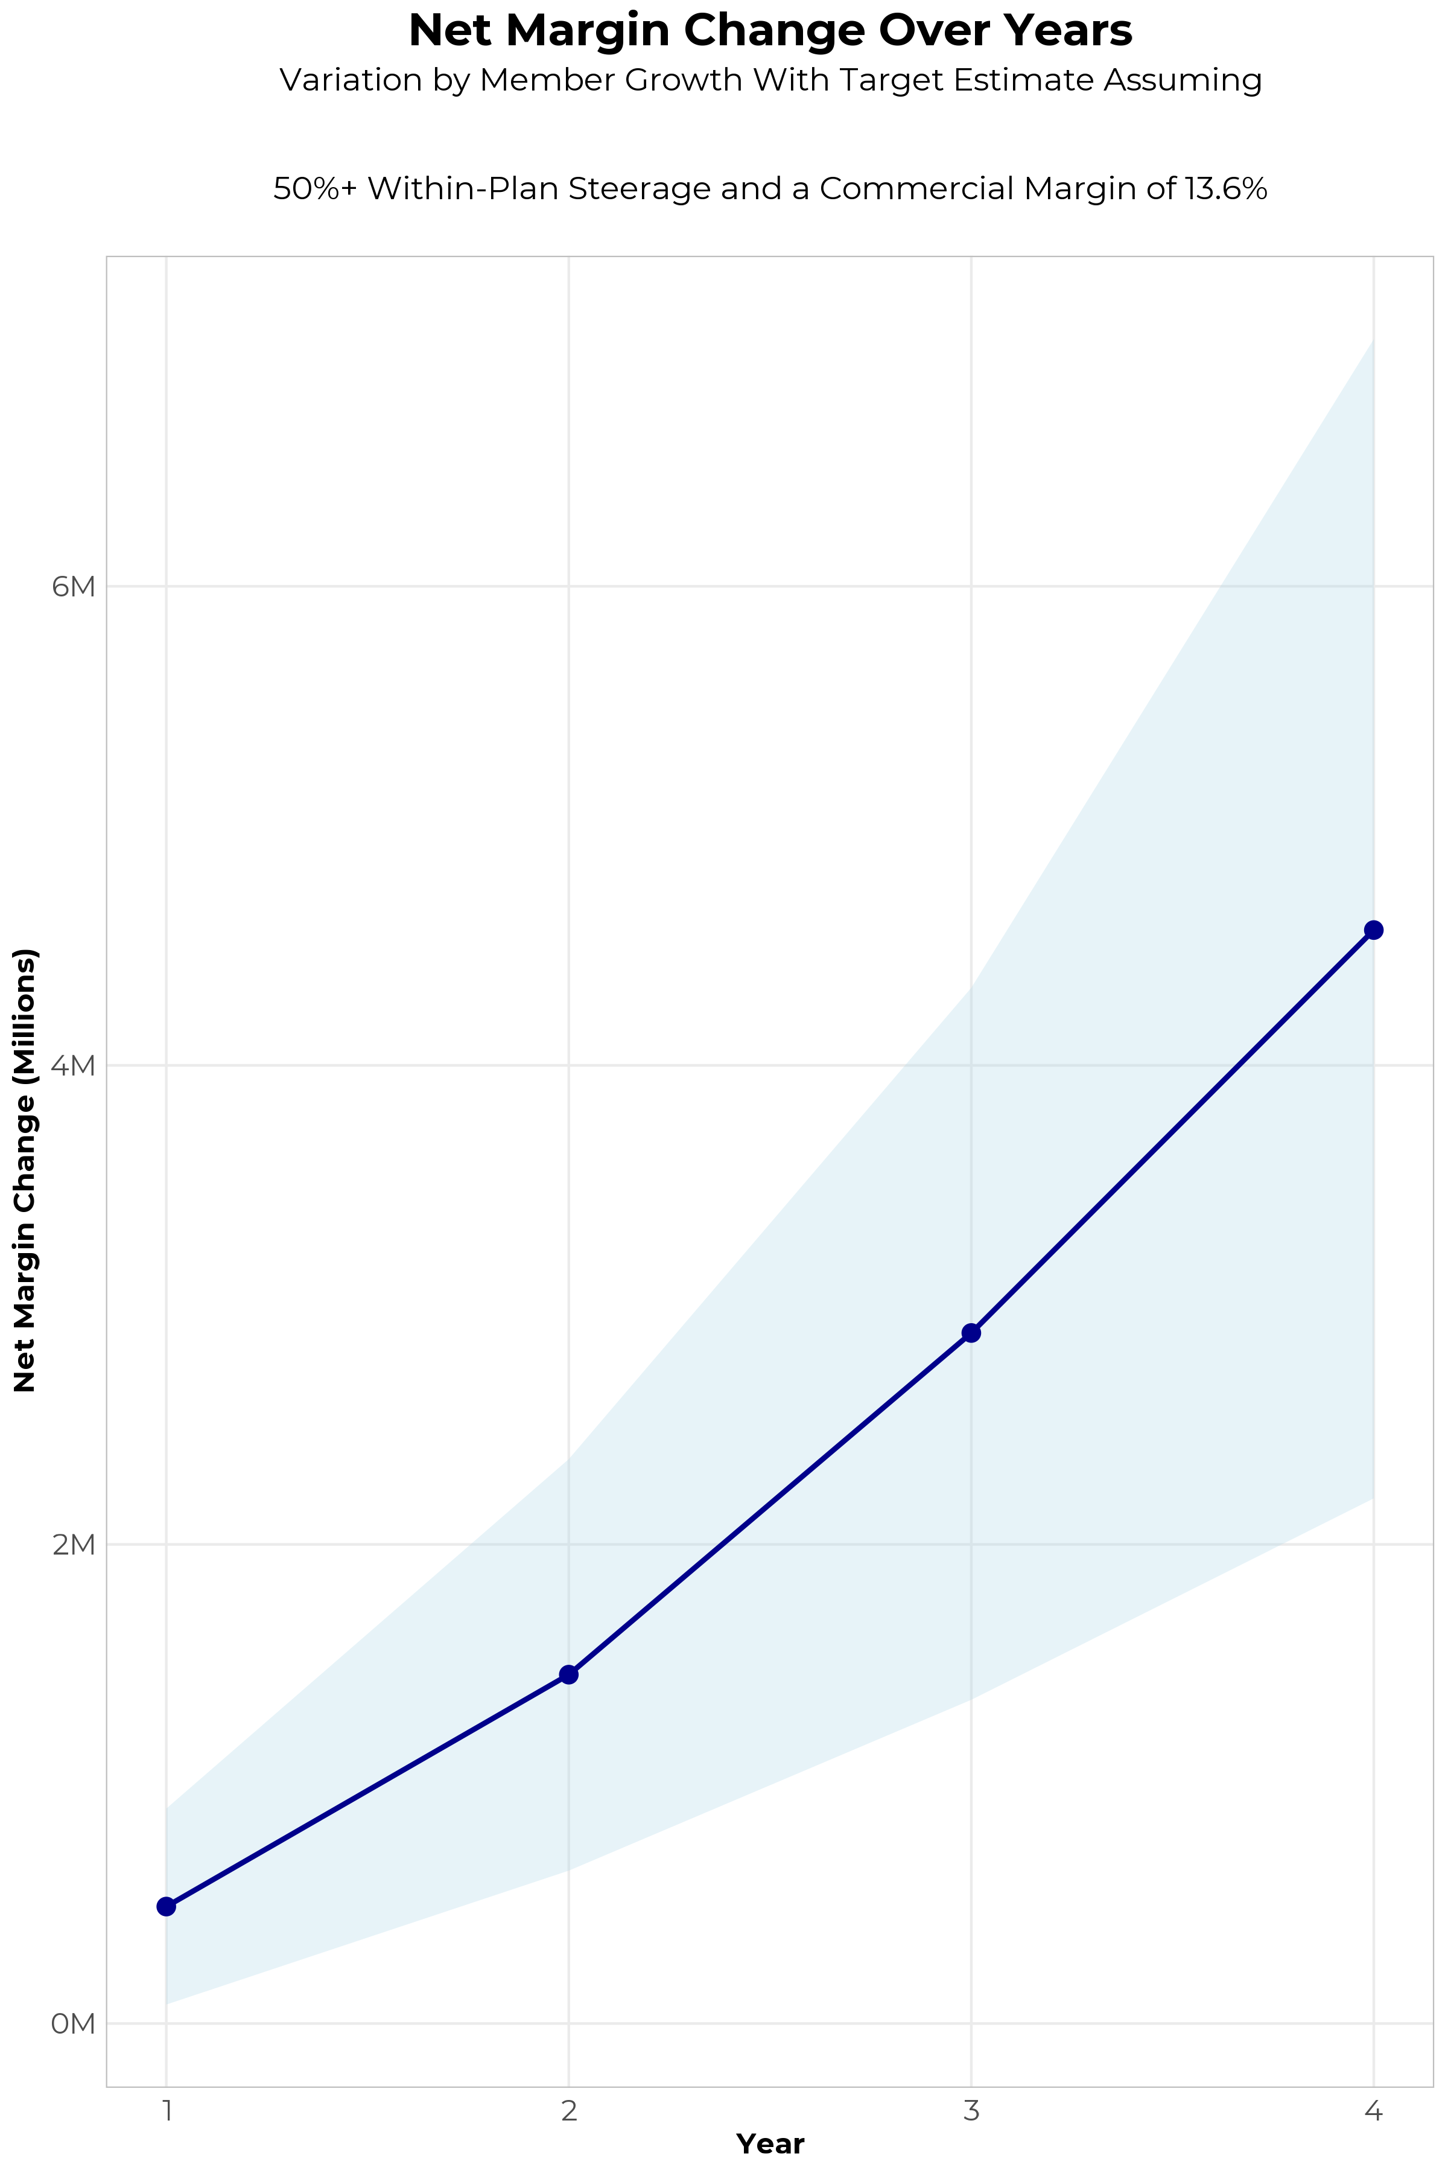
FOUR-YEAR PROJECTIONS
Target Member Growth | Target Member Growth | Target Member Growth | Target Member Growth | Target Member Growth
Metric | Year 1 | Year 2 | Year 3 | Year 4
Number of Members | 1,000 | 2,000 | 3,400 | 5,000
Incremental Margin | 806.1K | 1,612.3K | 3,021.9K | 4,684.8K
Network Access Fee | 12.0K | 24.0K | 40.8K | 60.0K
Implementation Fee (One-Time) | -150.0K | 0.0K | 0.0K | 0.0K
Sales and Marketing Costs | -180.0K | -180.0K | -180.0K | -180.0K
Net Margin Change | 488.1K | 1,456.3K | 2,882.7K | 4,564.8K
High Member Growth | High Member Growth | High Member Growth | High Member Growth | High Member Growth
Metric | Year 1 | Year 2 | Year 3 | Year 4
Number of Members | 1,500 | 3,100 | 5,000 | 7,600
Incremental Margin | 1,209.2K | 2,499.1K | 4,444.0K | 7,120.9K
Network Access Fee | 18.0K | 37.2K | 60.0K | 91.2K
Implementation Fee (One-Time) | -150.0K | 0.0K | 0.0K | 0.0K
Sales and Marketing Costs | -180.0K | -180.0K | -180.0K | -180.0K
Net Margin Change | 897.2K | 2,356.3K | 4,324.0K | 7,032.1K
Low Member Growth | Low Member Growth | Low Member Growth | Low Member Growth | Low Member Growth
Metric | Year 1 | Year 2 | Year 3 | Year 4
Number of Members | 500 | 1,000 | 1,700 | 2,500
Incremental Margin | 403.1K | 806.1K | 1,511.0K | 2,342.4K
Network Access Fee | 6.0K | 12.0K | 20.4K | 30.0K
Implementation Fee (One-Time) | -150.0K | 0.0K | 0.0K | 0.0K
Sales and Marketing Costs | -180.0K | -180.0K | -180.0K | -180.0K
Net Margin Change | 79.1K | 638.1K | 1,351.4K | 2,192.4K

Slide 13

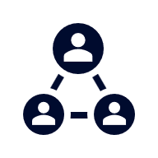



A PARTNER YOU CAN TRUST
OUR OBJECTIVES ARE ALIGNED
WE KNOW THE
MARKET
COMPLETELY TRANSPARENT
WE HAVE THE SOPHISTICATION AND INFRASTRUCTURE TO EFFECTIVELY COMPETE
Derek Moore, Senior Vice President – KBA
845-283-9973 * derek.moore@keybenefit.com

